Slide 1
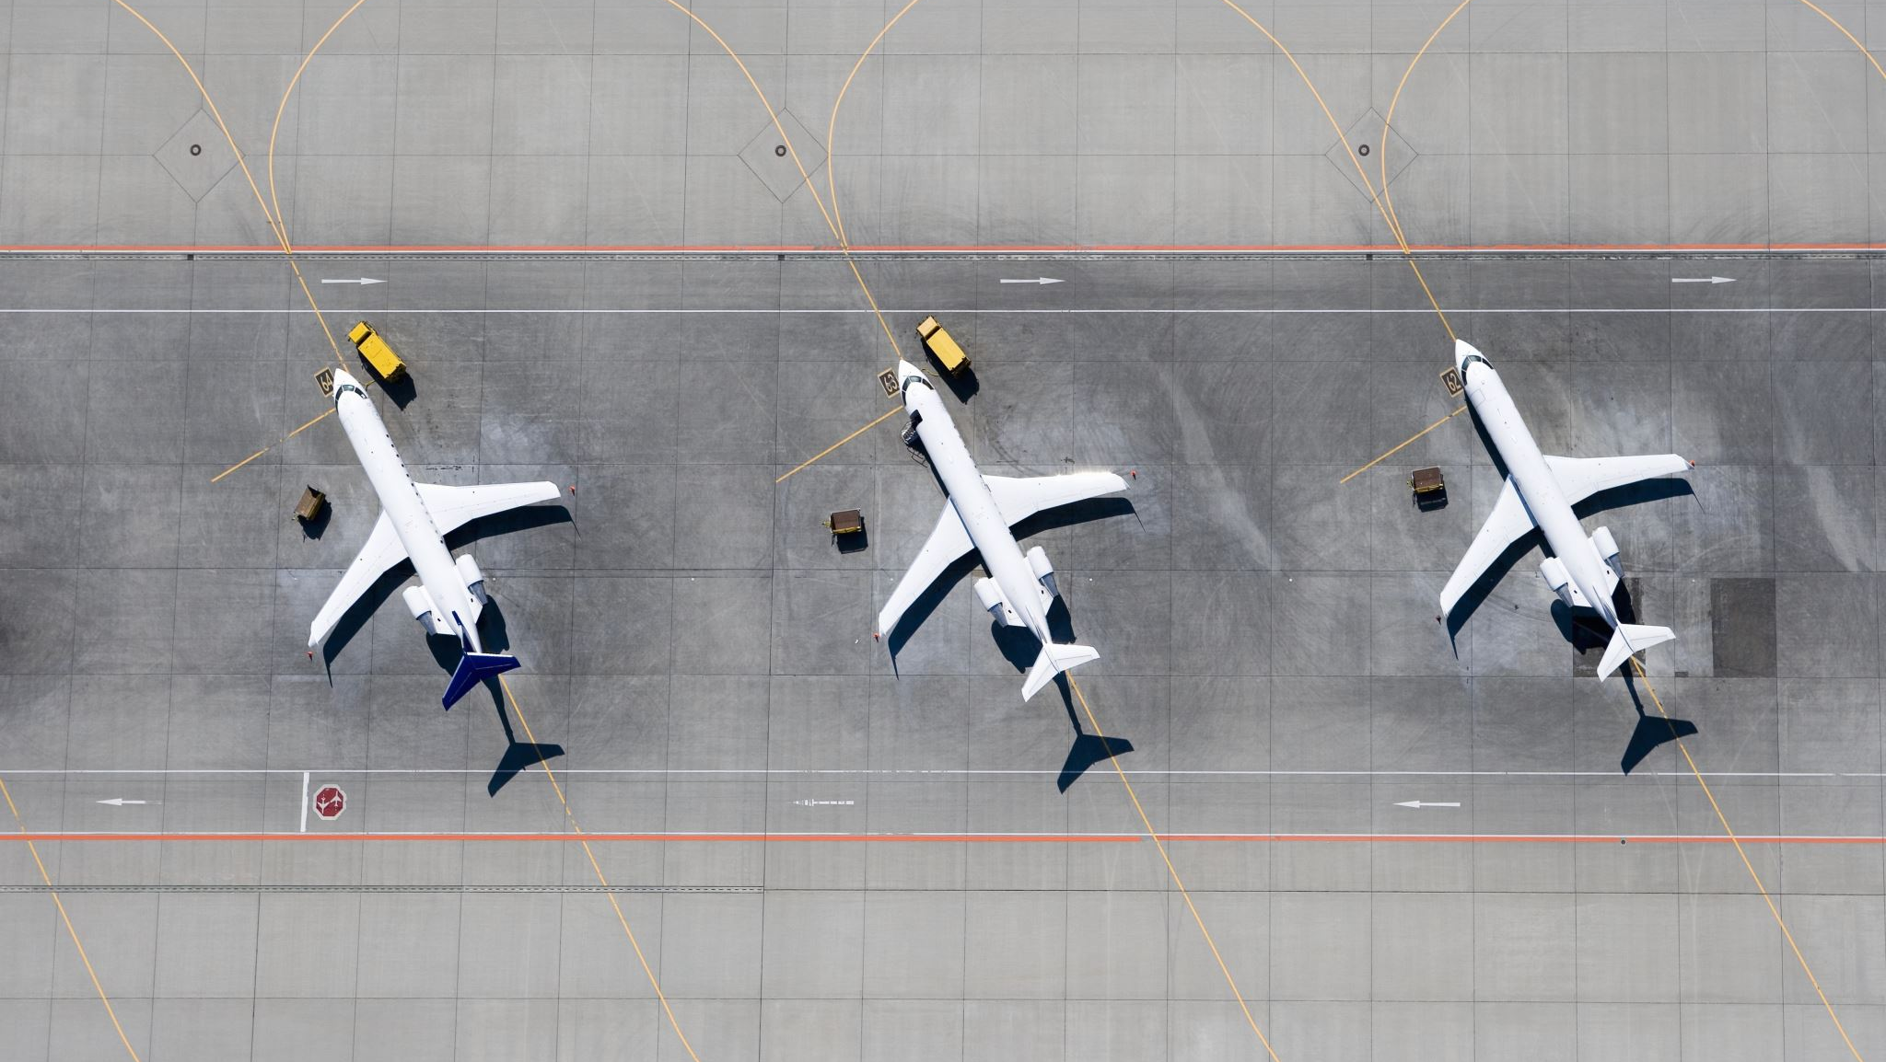
Predicting flight cancellations in advance with machine learning models

Slide 2
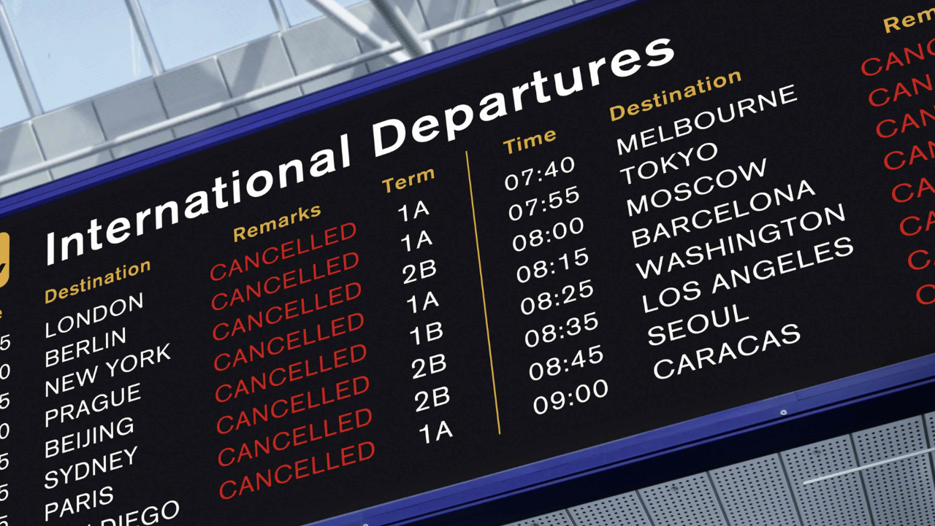
Flight cancellations does not only waste the time of travelers it may also make them lose money due to missed cruises, prepaid hotel rooms, increased parking fees, cancellation or postponement of business trips and additional cost of unplanned air tickets.

Slide 3

Problem Statement
What tool can be used by air travelers to predict flight cancellations in advance?

Slide 4

Solution
Building a model that predicts flight cancellations will serve as an important tool used by air travelers to predict flight cancellations in advance

Slide 5

Data Sources
1.The 2015 Flight Delays and Cancellations (kaggle.com) downloaded from Kaggle. It has about three files airlines.csv, airports.csv and flights.csv
2.airlinedelaycauses_DelayedFlights.csv also downloaded from Kaggle
3.The supplementary dataset was downloaded from Open data @ OurAirports
3. Supplementary dataset was downloaded from Open data @ OurAirports

Slide 6
Data Wrangling
Renaming datasets
Handling missing values
Handling abbreviated values
Handling duplicate columns
Merging
Resulting dataset
fl_delay
7755837 rows
42 columns

Slide 7
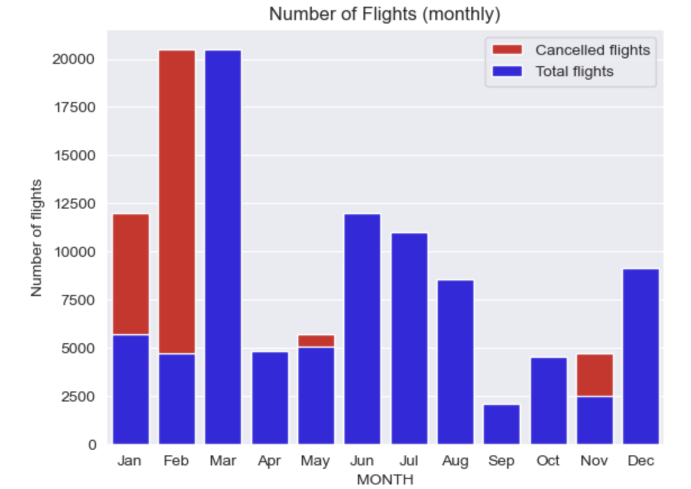
Exploratory Data Analysis
More flights were cancelled in November, January and February.
This may be due to harsh winter weather conditions.

Slide 8
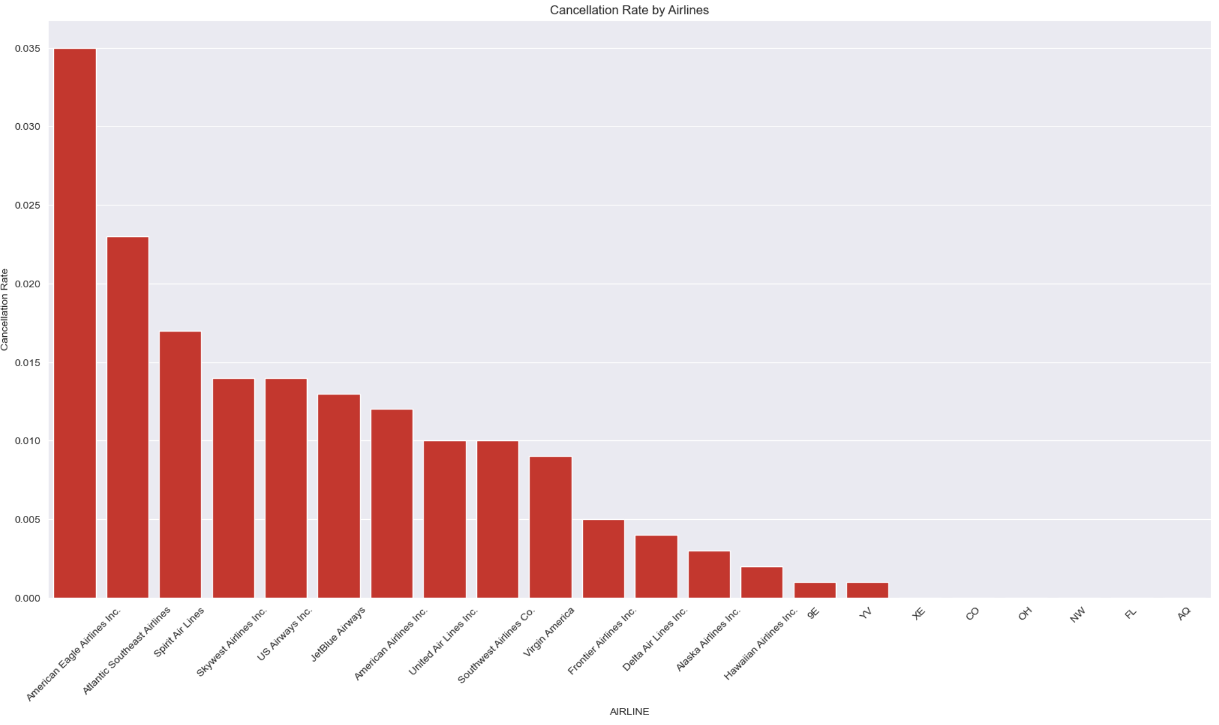
American Eagle Airlines Inc was responsible for the most flight cancellations at a cancellation rate of 3.5%.

Slide 9
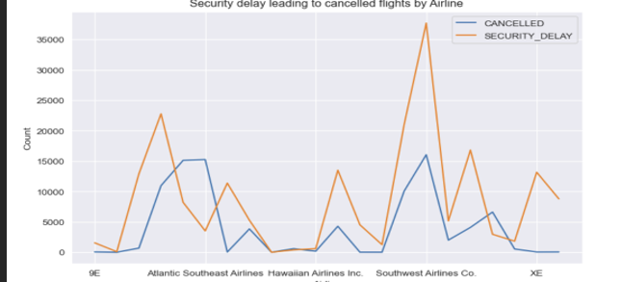
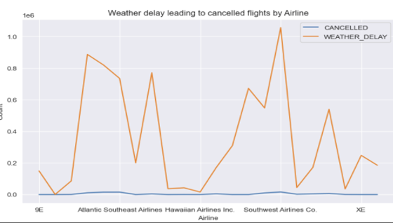
Security and Weather delays were most likely to cause flight cancellations.

Slide 10
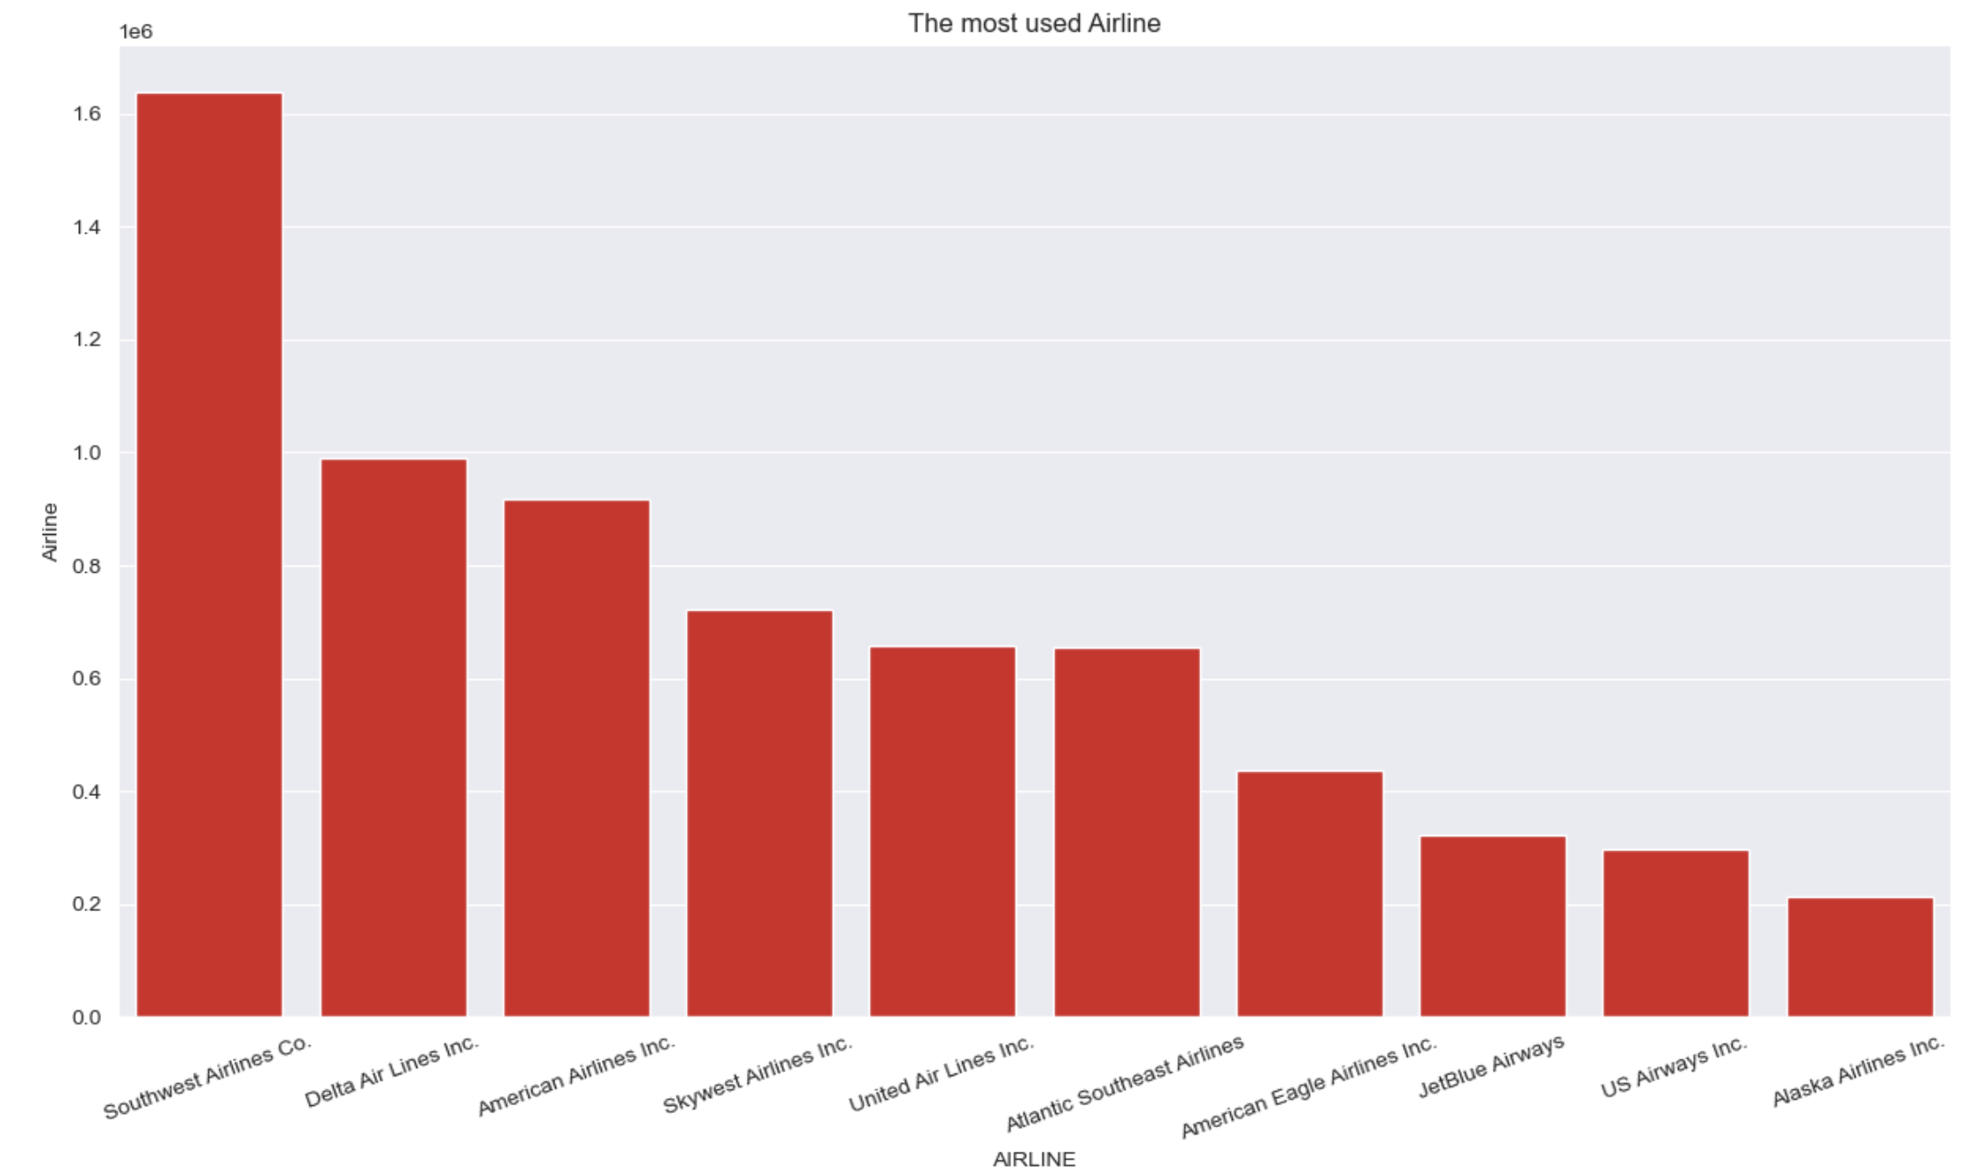
Southwest Airlines Co. has the most patronized flights

Slide 11
Preprocessing
delay features were dropped
id, ident, Cancellation reason, type, name, tail number, latitude_deg, longitude_deg, elevation_ft, iso_country, iata_code were dropped
Categorical columns like Origin and Destination airports were dropped
Airline and IATA code were encoded
X and y variables were defined
(dependent variable ‘CANCELLED’)
Data was split into training and test sets in the ratio 80:20 respectively

Slide 12
Modelling
Three machine learning models were built to predict flight cancellation.
Linear Regression Model.
Decision Tree Regressor with the max depth parameter set to 2.
Random Forest Classifier Model. The n_estimators parameter was set at 8.

Slide 13
Model Evaluation
Model Assessment | Linear Regression | Decision Tree Regressor
R-squared | 0.64 | 0.99
Mean absolute error | 0.032 | 0.002
Mean squared error | 0.064 | 0.0104
-Linear models

Slide 14
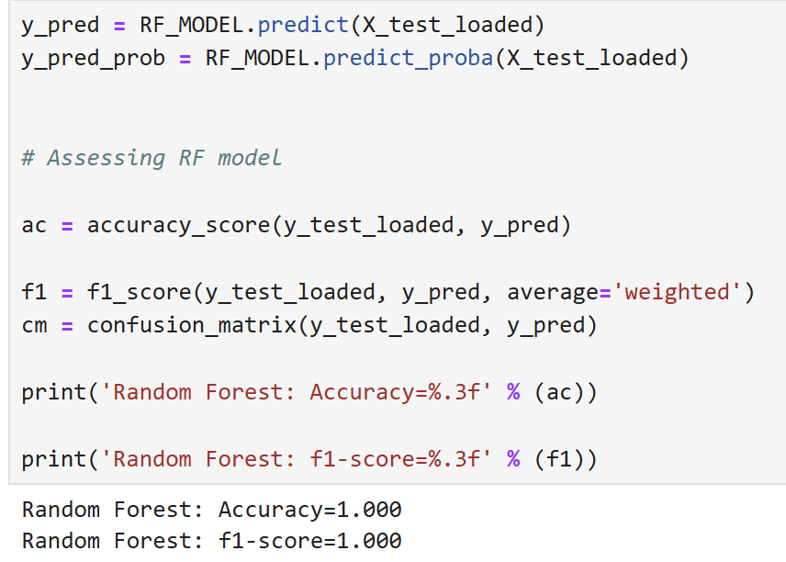
Model Evaluation
Random Forest Model

Slide 15
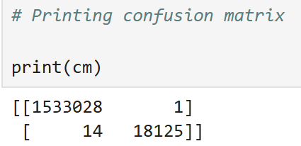
Random Forest Model
The confusion matrix indicated that the model was able to identify these;
18125 True negatives
1533028 True positives
1 False positive
14 False negatives

Slide 16
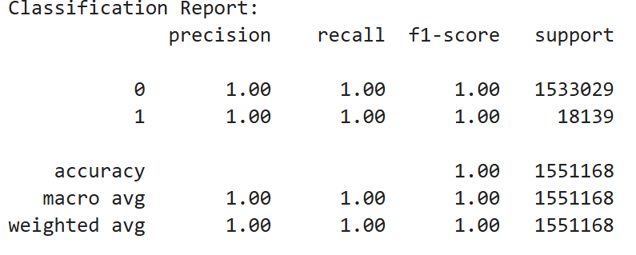
Random Forest Model
The classification reports showed that there is class imbalance. One class was 1533029 and the other class was 18139.
For this reason, the accuracy of the model was not as relevant as the precision and recall of the model.
The final performance of the model showed both precision and recall scores to be 1.0.

Slide 17
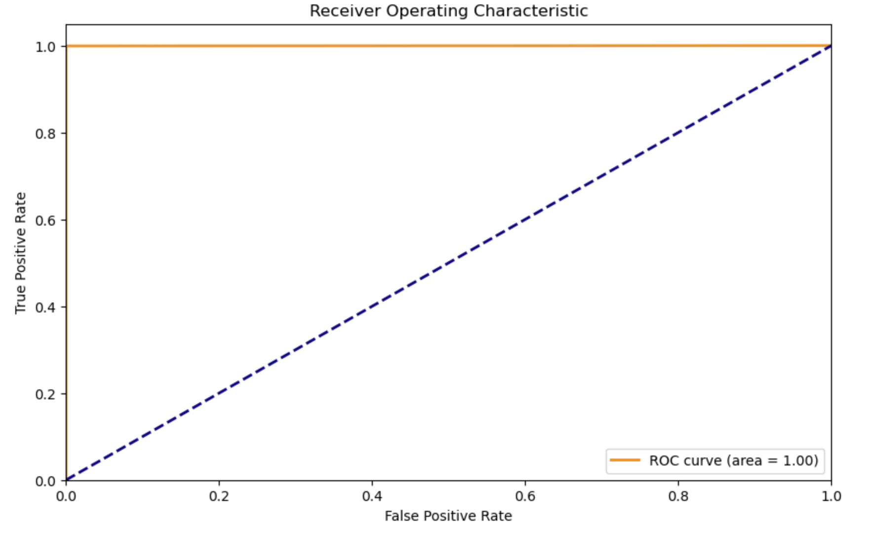
Random Forest Model
The graph proves that the diagnostic ability of the model is good.
The area under the curve value is 1.0 and it shows that the model can rank a randomly positive instance higher than a randomly negative instance.

Slide 18
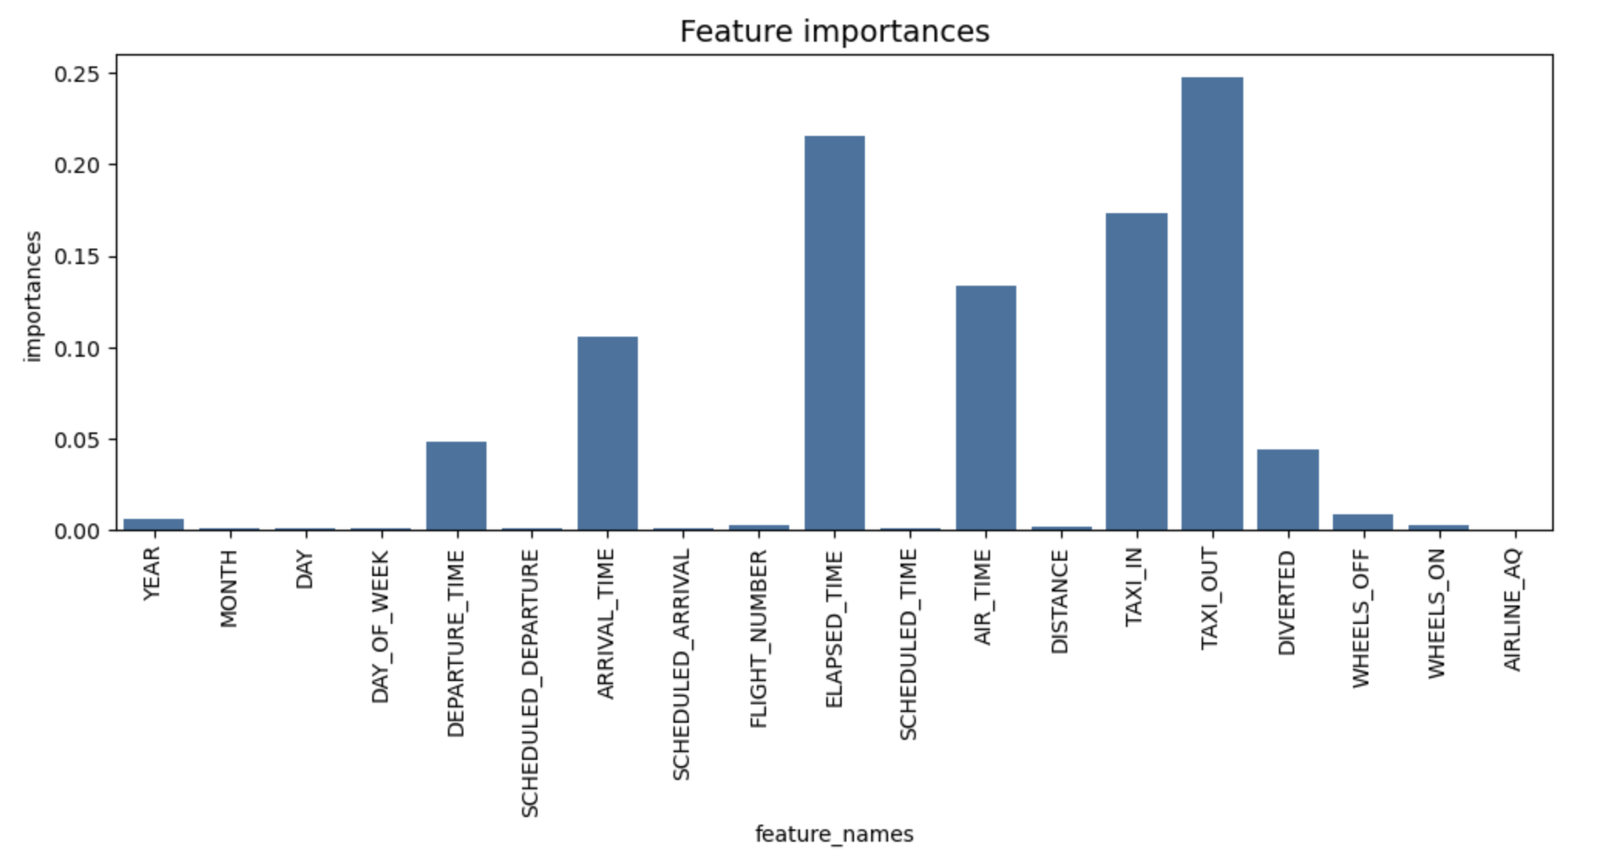
Random Forest Model
The most important features of this model are the taxi out, elapsed time and taxi in features.

Slide 19

Model Selection
The best model is the Random Forest Model
The poorest performing model is the Linear Model

Slide 20

Conclusion
Random Forest Model is the best predictive model for flight cancellations.
The most important feature for this model area taxi out, elapsed time and taxi in values
Model assessment indicates excellent precision, accuracy and f1 scores for this model

